Slide 1

Titolo presentazione sottotitolo
D.Marazzina
Blockchain
Milano, XX mese 20XX
Fintech

Slide 2
BLOCKCHAIN

Slide 3
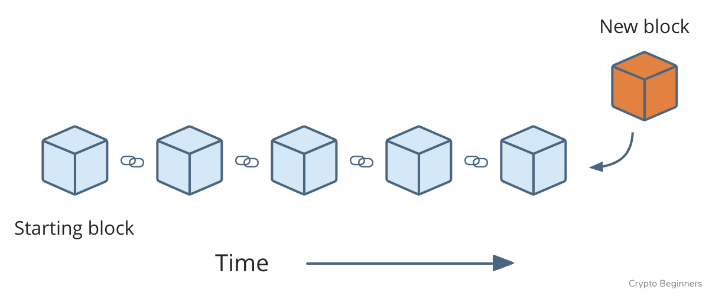
DLT
DLT=Distributed Ledger Technology
Distributed Ledger = a consensus of replicated, shared, and synchronized digital data geographically spread across multiple sites, countries, or institutions. No central authority
A blockchain is a decentralized, distributed, digital ledger consisting of records called blocks so that any involved block cannot be altered retroactively, without the alteration of all subsequent blocks.

Slide 4
Trust
In a distributed database, there is generally trust between the nodes on the network. In the case of Bitcoin, Ethereum, Algorand… trust between nodes is not required
Consensus Mechanism
Where is trust? Google Drive, Google Documents, Dropbox (shared files)
Where trust is not necessary? In the blockchain

Slide 5
Byzantine generals
The problem of the Byzantine generals is a computer problem on how to reach consensus in situations where errors are possible. The problem consists in finding an agreement, communicating only through messages, between different components in the event that there is conflicting information.
A curiosity: When the problem was conceived, in 1982, the author Leslie Lamport tried to make it easy to understand and remember by choosing a real nationality for the generals who were the protagonists of the story. To avoid causing discontent he initially opted for the definition of Albanian generals, assuming that this would have the least chance of generating offenses, but later decided on the name of Byzantine generals, so as to be sure that no people could feel directly called into question.

Slide 6
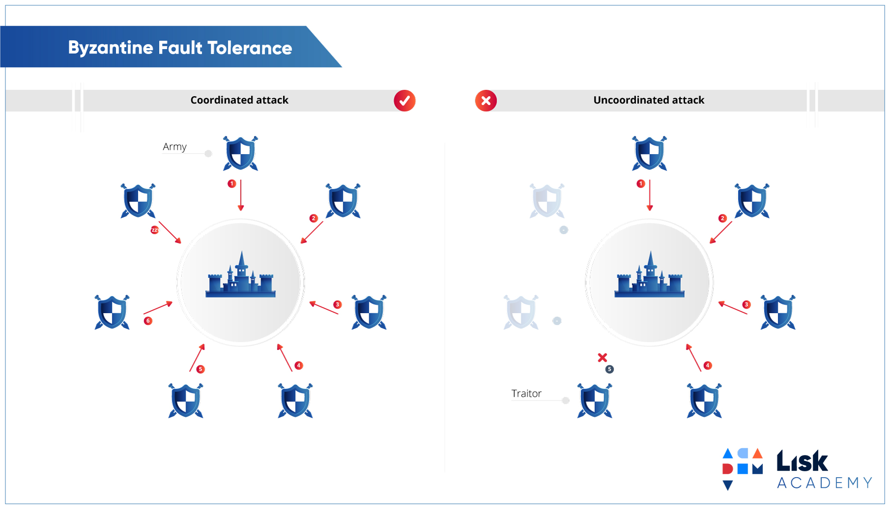

Slide 7
How to solve the problem?
What happens if a "node" (by mistake, or because it is dishonest) "propagates" an incorrect transaction?
The system must NOT validate this transaction to work.
As? Through consensus mechanisms!

Slide 8
Keywords
Consensus mechanism for lack of trust

Slide 9
BITCOIN and BLOCKCHAIN…

Slide 10

Bitcoin
Bitcoin is an electronic currency created in 2009, the inventor of which is known under the pseudonym Satoshi Nakamoto
It is one of the first cryptocurrency implementations: a decentralized digital currency that is based on the principles of cryptography to validate transactions and to generate money.

Slide 11
Keywords
Consensus mechanism for lack of trust
Decentralized database
Cryptography
Generation of new money

Slide 12
Keywords
Consensus mechanism for lack of trust
Decentralized database
Cryptography
Generation of new money

Slide 13
Keyword: Decentralization
Politically decentralized: Bitcoin is not controlled by a specific entity.
Architecturally decentralized (or distributed): Bitcoin lives on machines spread across the entire planet.
Logically centralized: all machines that Bitcoin lives on agree on a shared status (e.g. how many bitcoins each has).
A blockchain is a distributed (or architecturally decentralized) and politically decentralized database managed by a peer to peer network through distributed consensus mechanisms (in order to agree on a shared state, as logically centralized).

Slide 14
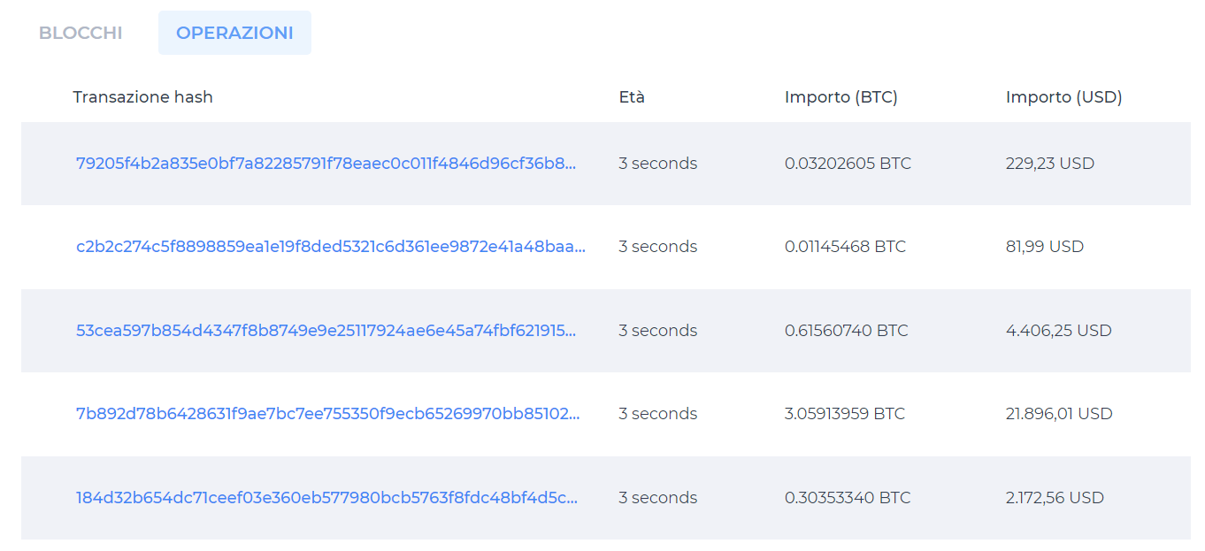
Bitcoin explorer
https://www.blockchain.com/explorer

Slide 15
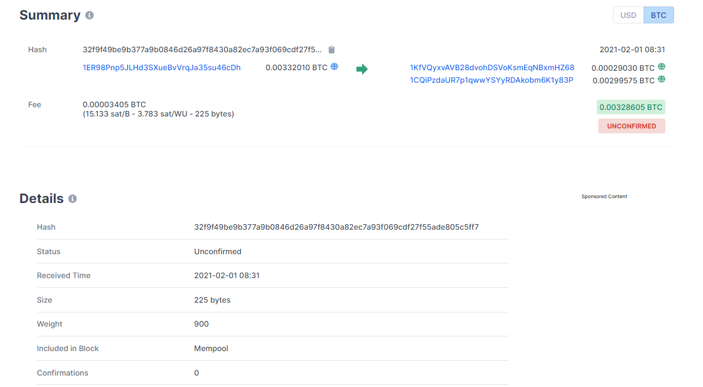

Slide 16
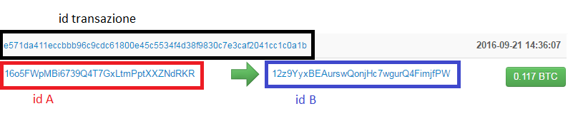
Transaction: A transaction is a Bitcoin transfer that is included in the Blockchain. A transaction is identified by the two addresses (counterparties) and by the amount exchanged.
The cryptographic private key signature of the two counterparties provides proof of their identity and that the Bitcoins come from the real owner. The signature also prevents that the transaction (once executed) is altered by others.
The two addresses are publicly identified by a code.

Slide 17
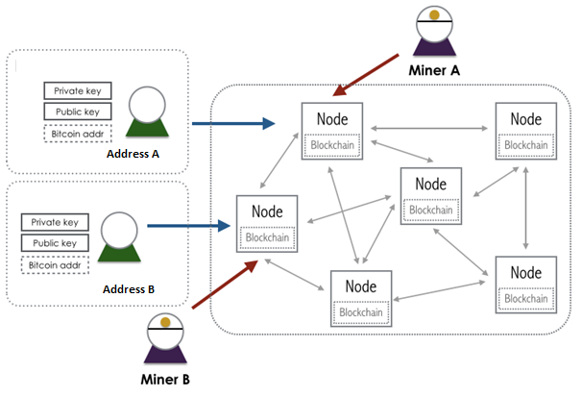
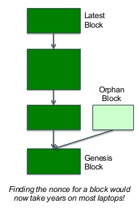
How a Blockchain work?

Slide 18
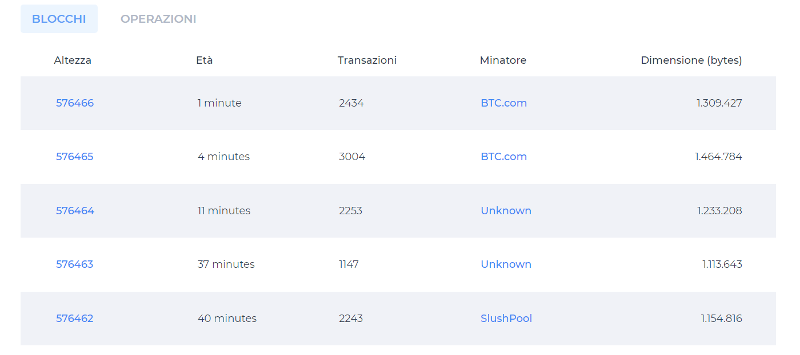

Slide 19
Block: A block is a part of the Blockchain that contains a set of (Bitcoin) transactions. On average, a new block, which includes transactions, is added to the Blockchain every ten minutes.
Confirmation: to be included in a block, and therefore in the Blockchain, a transaction must be confirmed by several nodes (miners), i.e. processed by the network.
Mining: it is a mathematical process performed by the Blockchain nodes on the candidate block: once solved the block (and therefore all the transactions recorded in it) is confirmed and inserted into a block of the Blockchain. As a reward for their service, miners receive newly created Bitcoins (and the transaction fees).

Slide 20
Miners accumulate transactions all the time (selecting them with a certain criterion, such as those that offer the highest fees).
When they have enough transactions to fill a block (which has a fixed size) they try to solve the mining problem.
The first miner that solves the mining problem propagates the block in the network, which is verified (they verify if the proof of work is valid) by the other nodes and added to their copy of the blockchain.

Slide 21
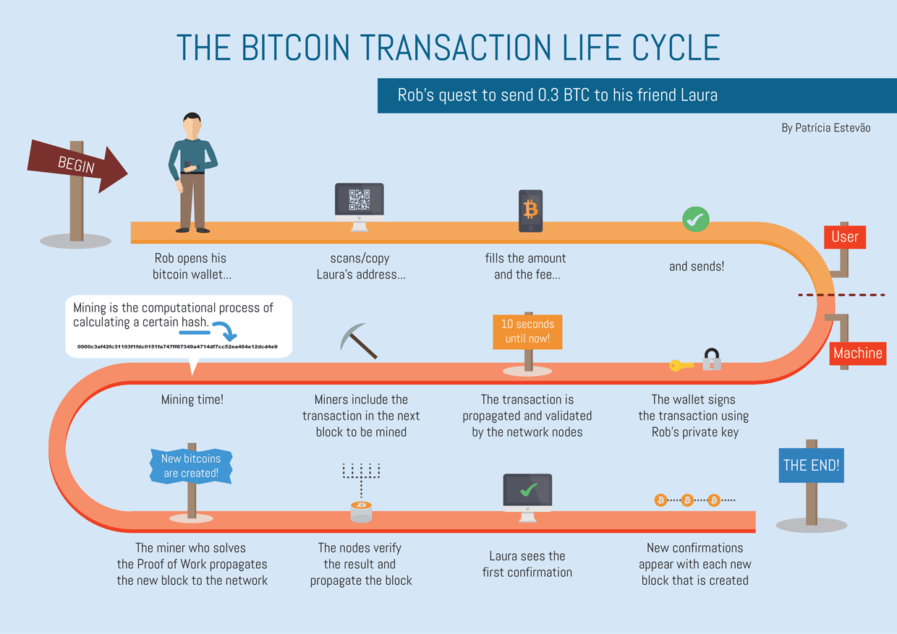

Slide 22
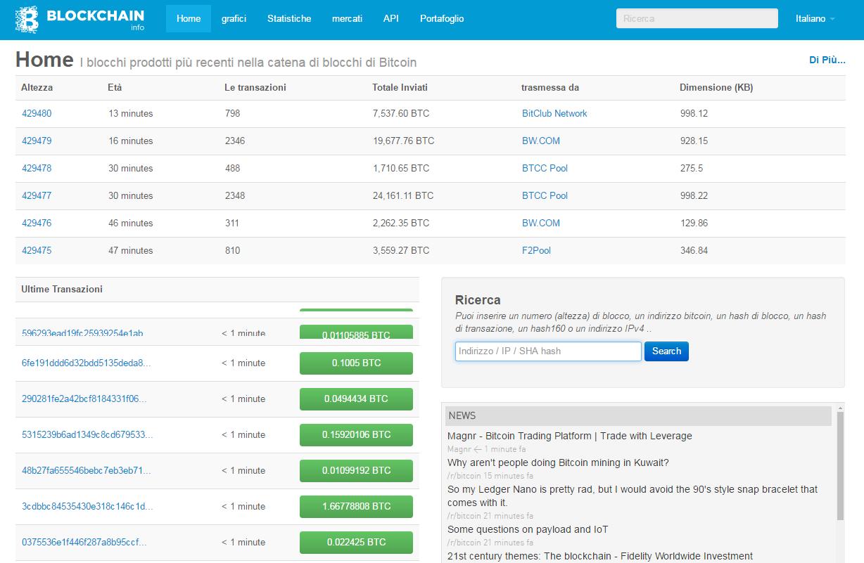

Slide 23
Keyword: cryptography
Cryptographic signature: it is a mathematical mechanism that allows you to prove the identity and ownership of Bitcoins in this case.
When your Bitcoin software marks a transaction with your private key, the entire network can recognize you (not as an individual but as an id) and verify that the Bitcoins spent are in your possession. The transaction becomes public with respect to your code.
There is currently no way for other nodes to guess your private key, to steal your Bitcoins.

Slide 24
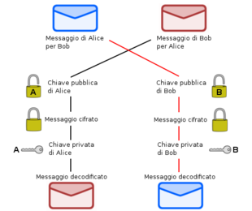
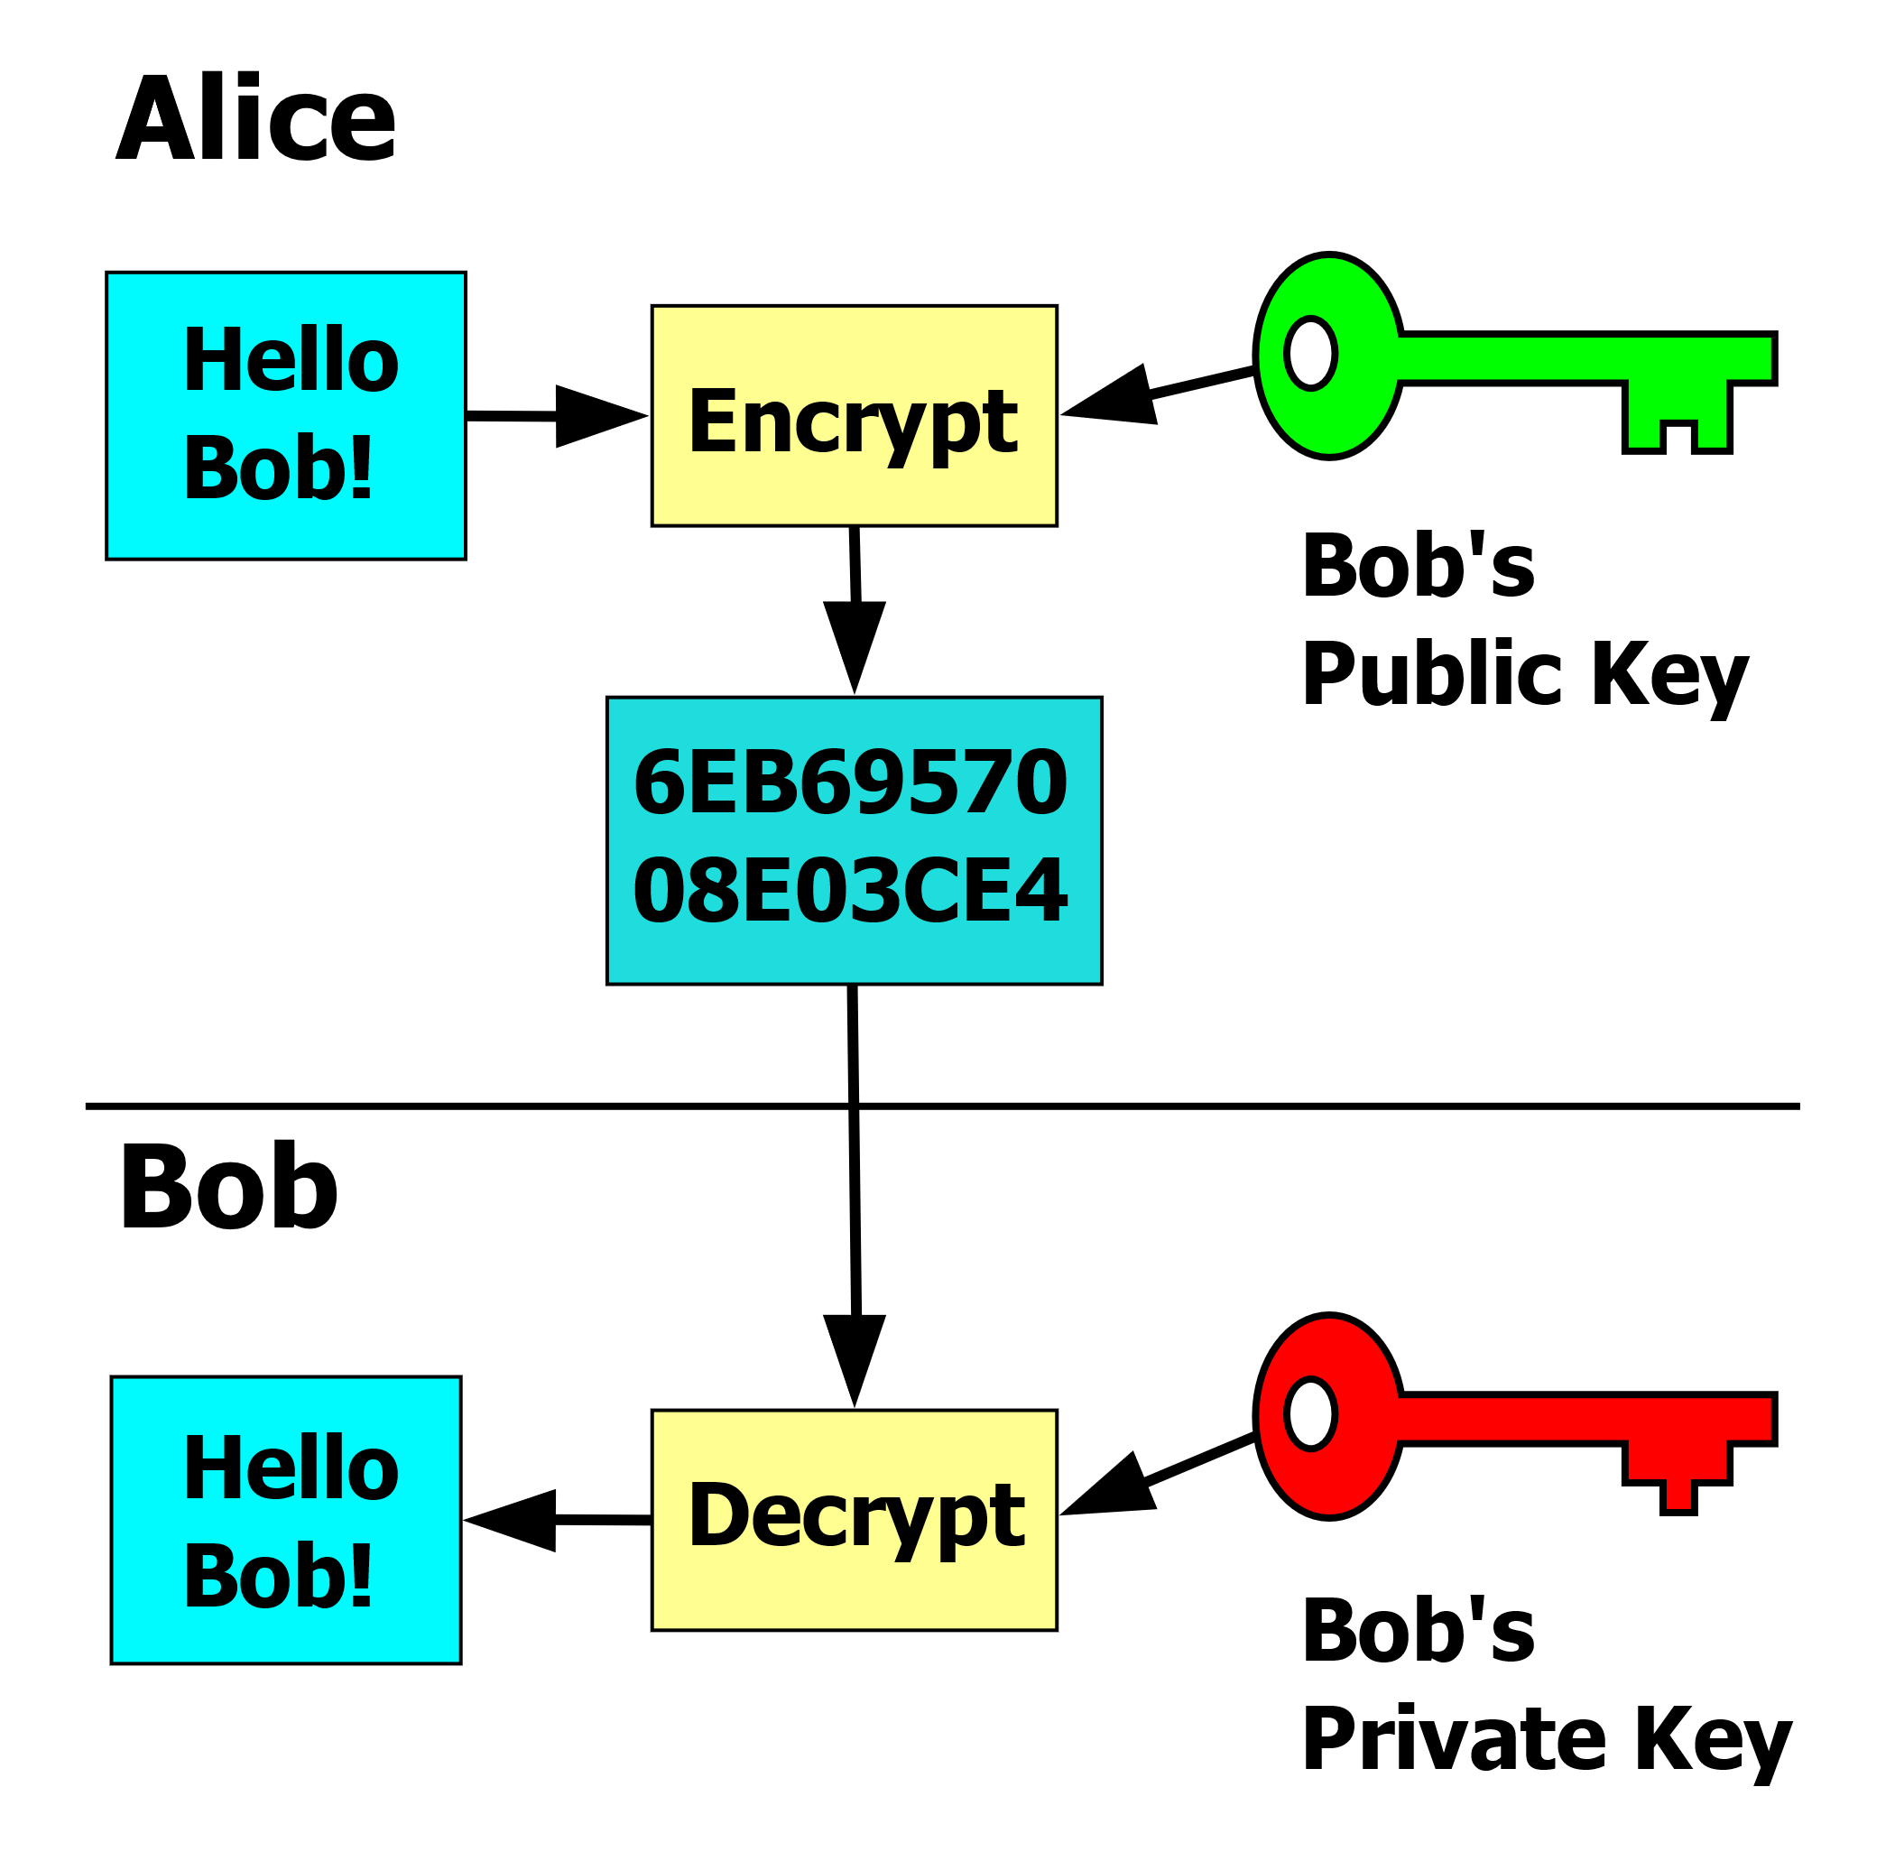
Digital (Cryptographic) signature
Asymmetric (or public key) encryption

Slide 25
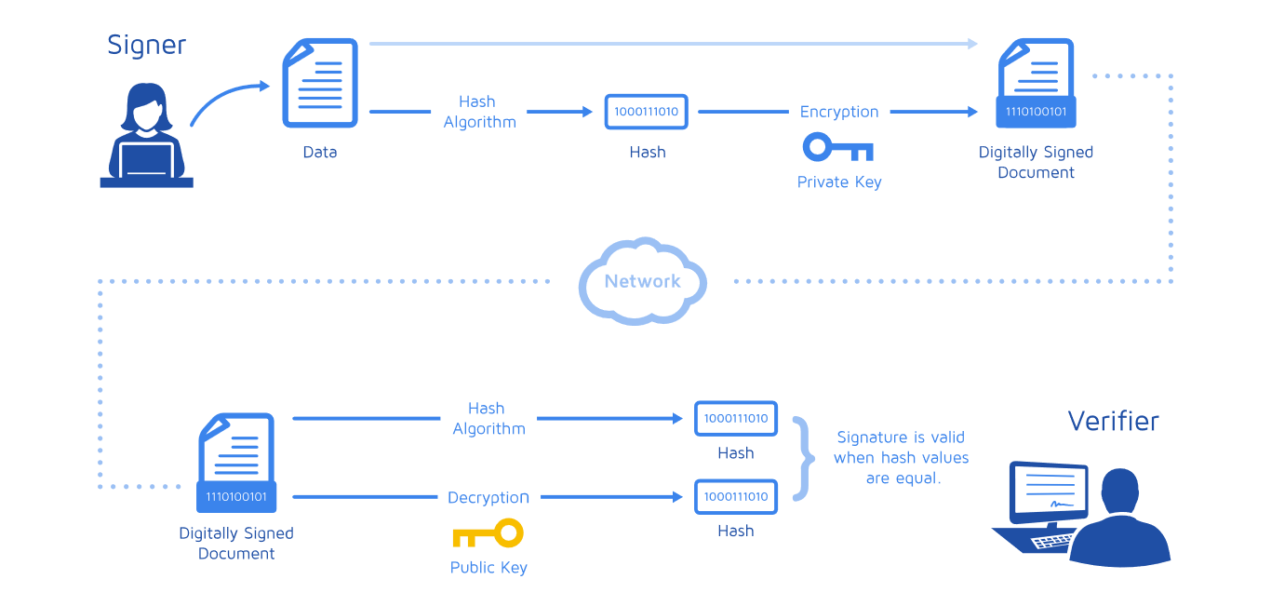
Digital Signature

Slide 26
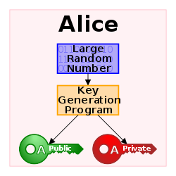
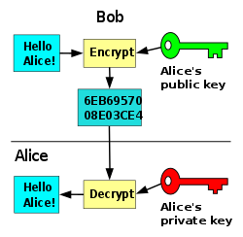
Step 1: a public-private key pair is generated for Alice
Step 2: Bob uses Alice's public key to encrypt the message. Only those who have Alice's private key can decrypt it!
So, if Alice has kept the private key hidden, only she can read the message

Slide 27
Elliptical encryption
Among the asymmetric cryptographies, Bitcoin uses Elliptical Cryptography
Public keys are based on the creation of a mathematical problem that is very difficult to solve without information, but which -with the use of some information (the private key)- becomes easy and quick to solve. The user publicly distributes the problem (the public key) and keeps the additional information hidden (the private key).

Slide 28
An example: RSA encryption
Let's take two prime numbers, 13 and 7 (and don't reveal them to anyone)
Let's multiply them together: we get n = 91
We choose a public key: 5
We use the Extended Euclidean Algorithm with inputs 5, 7 and 13, and we get the private key: 29
So n = 91, public key 5, private key 29

Slide 29
Let Alice and Bob know that n = 91, Alice's public key is 5, and her private key is 29.
Bob wants to send a message to Alice: the message is "3"
Then multiply 3 times 5 by itself, modulo 91
3 * 3 = 9
9 * 3 = 27
27 * 3 = 81
81 * 3 = 243> 91 → 243 (91) = 61
→ The public message is 61

Slide 30
a=3; at=3;
for i=1:5-1
at=mod(at*a,91)
end
→ Output=61
a=61; at=61;
for i=1:29-1
at=mod(at*a,91)
end
→ Output=3 → WE HAVE DECODED THE MESSAGE

Slide 31
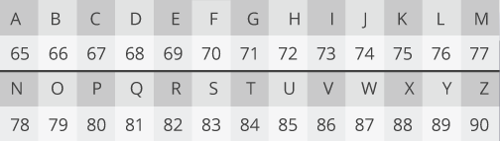
Message Encryption
Associate a number with each letter
Cloud = 67, 76, 79, 85, 68
Encrypt Cloud → 58, 20, 53, 50, 87

Slide 32
security
Alice and Bob know n = 91
Everyone knows 5
Only Alice knows 29
Knowing 5 (public key) is not sufficient to decrypt the message
Can Bob trace Alice's private key? That is, is the information "91" sufficient to compromise security?
Mathematical problem: factorization into prime numbers

Slide 33
Prime factorization is not the most difficult problem on a bit-to-bit basis. Specialized algorithms such as Quadratic Sieve and General Number Field Sieve were created to address the factorization problem and have had some success. These algorithms are faster and less computationally intensive than the naive approach of guessing pairs of known primes.
These factoring algorithms become more efficient as the size of the numbers considered increases. The gap between the difficulty of factoring large numbers and multiplying large numbers narrows as the number (i.e. the key bit length) increases. As the resources available to decrypt the numbers increase, the size of the keys must grow even faster. This is not a sustainable situation for mobile and low-power devices that have limited computational power. The gap between factoring and multiplication is not sustainable in the long term.
All of this means that RSA is not the ideal system for the future of cryptography.
→ Techniques based on Elliptical Curves
https://youtu.be/2RShPGAZqMs

Slide 34
Digital (Cryptographic) signature
Asymmetric algorithms guarantee confidentiality in communication. In fact, a message encrypted with the recipient's public key ensures that only the latter is able to decrypt this message, as it is the only one who has the corresponding private key.
Furthermore, by reversing the use of keys, that is, encrypting with the sender's private key and decrypting with the sender's public key, it is possible to guarantee authentication. It is on this principle that the digital signature is based.
The message is encrypted with the private key, so that anyone can, using the public key known by everyone, decrypt it and, in addition to being able to read it in clear text, be sure that the message was sent by the owner of the private key corresponding to the public one used to read it.

Slide 35
Let’s go back to the Blockchain…

Slide 36
What about miners?
In addition to checking that the digital signatures of the transactions are authentic, that there is no double spending, etc., and therefore verifying the transaction, their main job is to build the Blockchain, block by block.
As?
By concatenating the blocks together, and this happens with the solution of a computationally onerous mathematical problem.
If it were easily fixed, it would also be easy to attack the Blockchain.

Slide 37
Proof of Work
The Bitcoin Blockchain is therefore based on proof-of-work
Proof of Work, or PoW, is an algorithm that is used by different cryptocurrencies - such as Bitcoin- to reach a decentralized agreement between different nodes in the process of adding a specific block to the blockchain.
Hashcash (SHA-256) is the Proof of Work feature used by Bitcoin. Cryptocurrency forces miners to solve extremely complex and computationally difficult mathematical problems in order to add blocks to the blockchain. This function produces a very specific type of data that is used to verify that a significant amount of work has been done.

Slide 38
Hash function
“A hash function takes an input of any length and creates an output of fixed length.
It takes an input string and created a string of letters and numbers
“a0680c04c4eb53884be77b4e10677f2b”
This is referred to as the message digest.
It is also known as the digital fingerprint.”

Slide 39
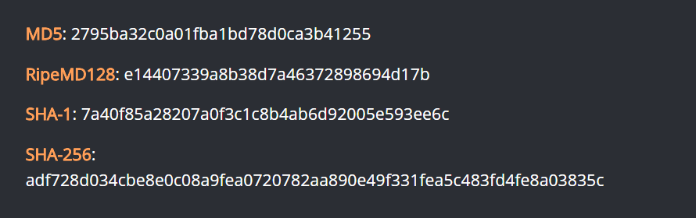
There are several types of hash functions
http://onlinemd5.com/

Slide 40
https://www.blockchain.com/it/btc/block/000000000000000000169176f5daf7c52fed81797b57113000da63233d43f306
The string we see is the hash of a block (64 characters long)
To calculate the hash of a block, we need, among other things:
Previous block hash ("prev_block")
Merkle root ("mrkl_root")
Time stamp ("time")
… And then Mining !!!
Every transaction has a hash associated with it. In a block, all of the transaction hashes in the block are themselves hashed (sometimes several times -- the exact process is complex), and the result is the Merkle root. In other words, the Merkle root is the hash of all the hashes of all the transactions in the block.

Slide 41
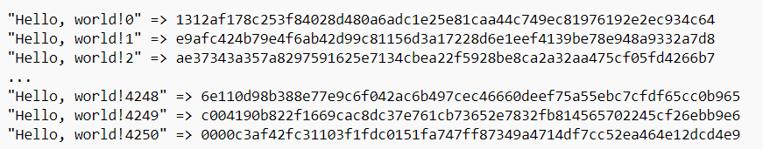
Hashing…
Hashing is fundamental for the blockchain: Bitcoin's PoW is based on this operation!
Our target is to find a variation of it that SHA-256 hashes to a value beginning with '000'. We vary the string by adding an integer value to the end called a nonce and incrementing it each time. Finding a match for "Hello, world!" takes us 4251 tries (but happens to have zeroes in the first four digits):
4251 hashes on a modern computer is not very much work (most computers can achieve at least 4 million hashes per second). Bitcoin automatically varies the difficulty (and thus the amount of work required to generate a block) to keep a roughly constant rate of block generation.

Slide 42
A POW system discourages attacks and other abuse of service by enforcing certain jobs that require a computer's high processing time. A key feature of these works is their asymmetry: the work must be moderately, but easy to control.
Game theory: the nodes of the network compete with each other to register the new block thus obtaining a compensation. Thanks to the expected remuneration, most of the nodes have an interest in behaving in a "legitimate" manner, thus contributing to the growth of the blockchain.

Slide 43
Not only PoW…
Proof of Stake is an alternative method, a way by which nodes reach a consensus.
In the Proof of Stake consensus model, the number of digital currency tokens held by each user is an important issue within the system. The greater the stake (“stake”), ie the amount of tokens owned by a user, the greater the chances that the system is not being breached. The more an individual is exposed to a cryptocurrency, the more likely they are to perform optimally.
The Proof of Stake blocks, unlike the Proof of Work blocks, are not mined, but minted. Participants who have a significant stake in Proof of Stake systems are selected on a pseudorandom basis to mint the blocks and add them to the blockchain.

Slide 44
Ethereum Proof of Stake
Ethereum moved from PoV to PoS
Proof of stake does away with miners and replaces them with “validators.” Instead of investing in energy-intensive computer farms, you invest in the native coins of the system. To become a validator and to win the block rewards, you lock up—or stake—your tokens in a smart contract, a bit of computer code that runs on the blockchain. When you send cryptocurrency to the smart contract’s wallet address, the contract holds that currency, sort of like depositing money in a vault.

Slide 45
In the proof-of-stake system Ethereum is slowly moving to, you put up 32 ether—currently worth $100,000—to become a validator. If you don’t have that kind of spare change on hand, and not many people do, you can join a staking service where participants serve as validators jointly.
An algorithm selects from a pool of validators based on the amount of funds they have locked up. The more you stake, the greater your chance of “winning the lottery.” If you’re chosen and your block is accepted by a committee of “attestors”—a group of validators randomly chosen by an algorithm—you are awarded newly minted ether.

Slide 46
Ethereum’s proponents claim that a key advantage proof of stake offers over proof of work is an economic incentive to play by the rules. If a node validates bad transactions or blocks, the validators face “slashing,” which means all their ether are “burned.” (When coins are burned, they are sent to an unusable wallet address where nobody has access to the key, rendering them effectively useless forever.)

Slide 47
In summary ...
The Blockchain is a public ledger of Bitcoin transactions in chronological order.
It is used to permanently store Bitcoin transactions and to prevent double spending.
As the name suggests, the Blockchain is a set of interlinked blocks: each block is identified by a code, contains the information of a series of transactions, and contains the code of the previous block, so that it is possible to retrace the chain at the back to the original block. A DNA of Bitcoin transactions.
All the nodes of the network store all the blocks and therefore the whole Blockchain

Slide 48
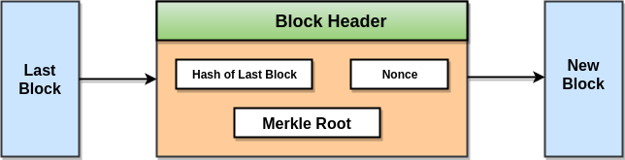
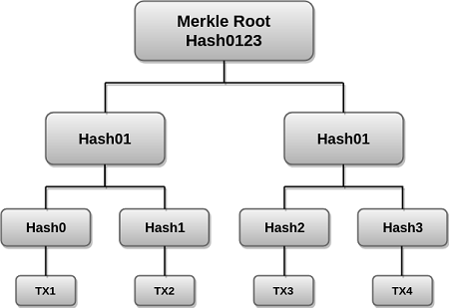
PoW - how it works Let us consider Bitcoin
A Merkle tree stores all the transactions in a block by producing a digital fingerprint of the entire set of transactions.
Merkle trees are created by repeatedly calculating hashing pairs of nodes until there is only one hash left. This hash is called the Merkle Root, or the Root Hash. The Merkle Trees are constructed in a bottom-up approach.
Every leaf node is a hash of transactional data, and the non-leaf node is a hash of its previous hashes. Merkle trees are in a binary tree, so it requires an even number of leaf nodes. If there is an odd number of transactions, the last hash will be duplicated once to create an even number of leaf nodes.

Slide 49
The Merkle Tree maintains the integrity of the data. If any single detail of transactions or order of the transaction's changes, then these changes reflected in the hash of that transaction. This change would cascade up the Merkle Tree to the Merkle Root
https://www.blockchain.com/explorer/blocks/btc/782799
M=Merkle Root: bab222cddaebc65ddbf2afd6d1e9a9fbbce29771b6e5bbc71ea8d40d60d89215
PB=Previous Block Hash: 000000000000000000052ffd4156bdab33238a083a83f8b2d97c31bf572a2fa7
N=Nonce: 1,617,333,896
NB=This Block Hash: 00000000000000000005293633281261d675cbccb21dfee2aa52b4137211628a
Find N such that F(M,PB,N) starts with 19 zeros → difficult (in order to have a block every 10 minutes – on average) → brute force only
Check that F(M,PB,N) starts with 19 zeros → easy!
F(M,PB,N)= 00000000000000000005293633281261d675cbccb21dfee2aa52b4137211628a

Slide 50
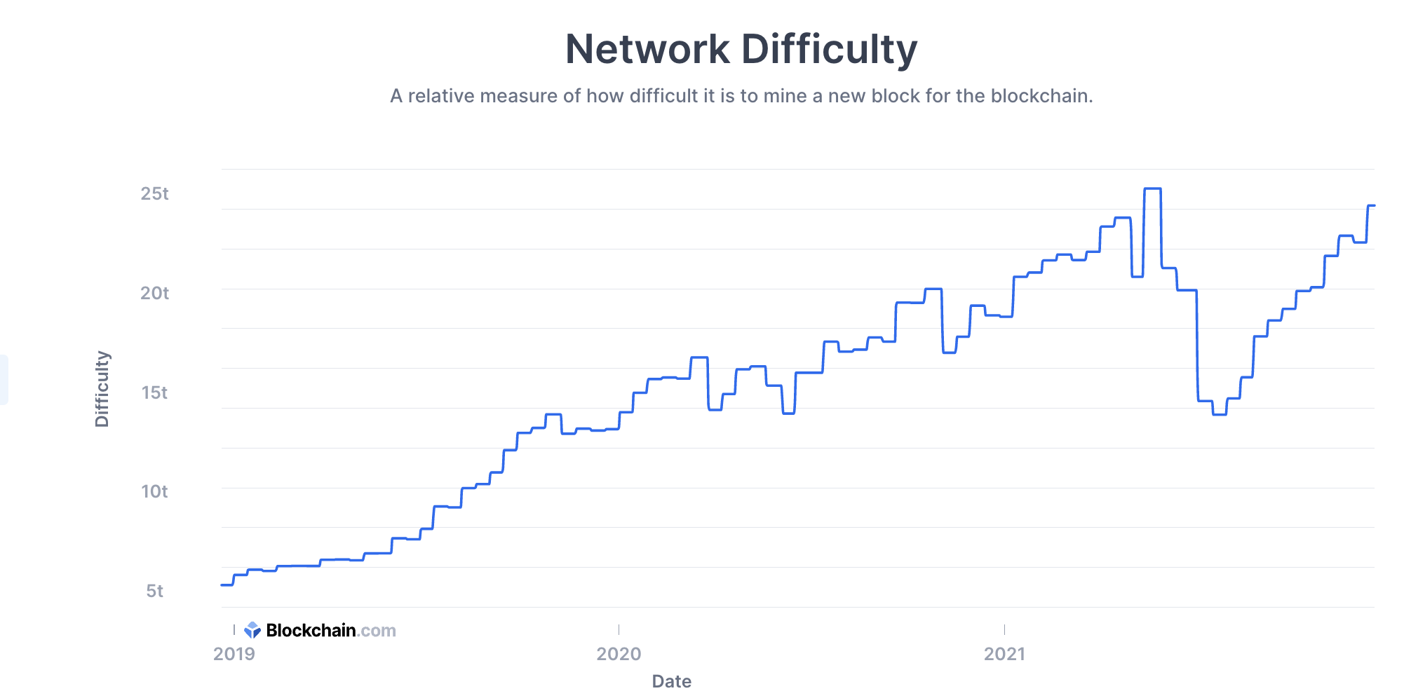
Number of zeros
There are small adjustments being made after each difficulty epoch since the computational power on the network fluctuates. However the most notable change in network difficulty was during the summer of 2021 when China announced that it was banning mining activity in the country. As a result, mining firms switched off their machines and scrambled to move them to other territories. This lead to a temporary drop in hashrate on the network and through the next difficulty adjustments the network self regulated by dropping the difficulty by a whopping 28% - the biggest downward adjustment in the history of the network. Then as mining firms resumed their activity in their new locations, the difficulty steadily adjusted back upwards.

Slide 51
PoS - how it works - Let us consider Ethereum
Proof-of-stake (PoS) underlies Ethereum's consensus mechanism. Ethereum switched on its proof-of-stake mechanism in 2022 because it is less energy-intensive, and better for implementing new scaling solutions compared to the previous proof-of-work architecture
To participate as a validator, a user must deposit 32 ETH into the deposit contract and run three separate pieces of software: an execution client, a consensus client, and a validator.
On depositing their ETH, the user joins an activation queue that limits the rate of new validators joining the network.
Once activated, validators receive new blocks from peers on the Ethereum network. The transactions delivered in the block are re-executed, and the block signature is checked to ensure the block is valid. The validator then sends a vote (called an attestation) in favor of that block across the network.
Whereas under proof-of-work, the timing of blocks is determined by the mining difficulty, in proof-of-stake, the time is fixed. Time in proof-of-stake Ethereum is divided into slots (12 seconds) and epochs (32 slots). One validator is randomly selected to be a block proposer in every slot. This validator is responsible for creating a new block and sending it out to other nodes on the network. Also in every slot, a committee of validators is randomly chosen, whose votes are used to determine the validity of the block being proposed.

Slide 52
Running a validator is a commitment. The validator is expected to maintain sufficient hardware and connectivity to participate in block validation and proposal. In return, the validator is paid in ETH (their staked balance increases).
On the other hand, participating as a validator also opens new avenues for users to attack the network for personal gain or sabotage.
To prevent this, validators miss out on ETH rewards if they fail to participate when called upon, and their existing stake can be destroyed if they behave dishonestly.
There are two primary behaviors that can be considered dishonest: proposing multiple blocks in a single slot (equivocating) and submitting contradictory attestations.
When the network performs optimally and honestly, there is only ever one new block at the head of the chain, and all validators attest to it. However, it is possible for validators to have different views of the head of the chain due to network latency or because a block proposer has equivocated. Therefore, consensus clients require an algorithm to decide which one to favor. The algorithm used in proof-of-stake Ethereum works by identifying the fork that has the greatest weight of attestations in its history.
The threat of a 51% attack still exists on proof-of-stake as it does on proof-of-work, but it's even riskier for the attackers. An attacker would need 51% of the staked ETH. They could then use their own attestations to ensure their preferred fork was the one with the most accumulated attestations. The 'weight' of accumulated attestations is what consensus clients use to determine the correct chain, so this attacker would be able to make their fork the canonical one. However, a strength of proof-of-stake over proof-of-work is that the community has flexibility in mounting a counter-attack. For example, the honest validators could decide to keep building on the minority chain and ignore the attacker's fork while encouraging apps, exchanges, and pools to do the same. They could also decide to forcibly remove the attacker from the network and destroy their staked ETH. These are strong economic defenses against a 51% attack.

Slide 53
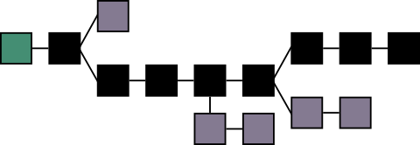
Uniqueness
The chain is unique: if two different chains are created (for example, due to a delay in updating the blocks), the '' incorrect '' one is automatically deleted and overwritten by the correct one.
To determine the correct chain, there are automatisms: the chain considered correct is always the longest one (longest chain rule).
Notes:
Qui è un po' impreciso.
La catena ritenuta corretta è sempre quella più lunga (per la longest chain rule).
Generalmente la catena più lunga è anche quella memorizzata dalla maggioranza dei nodi della rete, dato che i miner sono costantemente incentivati a creare blocchi validi (ovvero fare i bravi) attraverso le fee e i bitcoin generati ad ogni risoluzione del problema di mining.
Da un punto di vista della teoria dei giochi, collaborare alla catena più lunga è un equilibrio, dato che nessuno può ottenere un risultato migliore per se stesso (senza collaborare con altri) creando blocchi non validi.

Slide 54
Generally, the longest chain is also the one stored by the majority of the network nodes (50% + 1 rule), given that miners are constantly incentivized to create valid blocks through the fees and bitcoins generated at each resolution of the mining problem.
From a game theory perspective, collaborating on the longest chain is a balance, as no one can achieve a better result for themselves (without collaborating with others) by creating invalid blocks (PoWs). This makes it very difficult for a hacker to change even the last block.

Slide 55
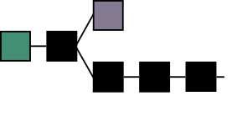
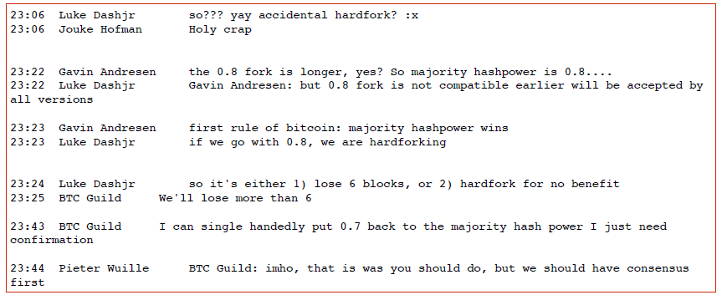
An example of distributed consensus (or maybe not)
BTC Guild can choose:
«longer chain rule» VS «50%+1» rule

Slide 56
Hard fork and soft fork
Forks are modifications to the blockchain’s network algorithm that leads to the primary blockchain network to split.
A hard fork is a backward-incompatible upgrade to the blockchain.
In the hard fork new nodes can only communicate with others that operate the new version. As a result, the blockchain splits, creating two separate networks: one with the old rules, and one with the new rules. So there are now two networks running in parallel. They’ll both continue to propagate blocks and transactions, but they’re no longer working on the same blockchain. All nodes had an identical blockchain until the point of the fork (and that history remains), but they’ll have different blocks and transactions afterward. Because there’s that shared history, you’ll end up with coins on both networks if you were holding them before the fork.
A soft fork is a backward-compatible upgrade, meaning that the upgraded nodes can still communicate with the non-upgraded ones. What you typically see in a soft fork is the addition of a new rule that doesn’t clash with the older rules.
A good real-life example of a soft fork was the Segregated Witness (SegWit) fork, which occurred shortly after the Bitcoin/Bitcoin Cash split. SegWit was an update that changed the format of blocks and transactions, but it was cleverly crafted. Old nodes could still validate blocks and transactions (the formatting didn’t break the rules), but they just wouldn’t understand them. Some fields are only readable when nodes switch to the newer software, which allows them to parse additional data.

Slide 57
Creating new Bitcoin
We talked about computational cost, but who pays the nodes?
The system itself: there is an algorithm for generating new Bitcoins, and the generated digital currency is given to the nodes. Furthermore, there are fees for each planned transaction.
This is a key step !!!
Notes:
I bitcoin dati ai miner sono stabiliti a priori e non dipendono dalla potenza di calcolo della rete (dimezzano ogni tot) e il piano è che ad un certo punto l'unica ricompensa che i miner riceveranno saranno le fee.
Ciò che dipende dalla potenza di calcolo è la complessità del problema di mining. Questa complessità viene regolata in modo tale che ci vogliano mediamente 10 minuti affinché la rete, nel suo complesso, crei un nuovo blocco.
In media, nota la potenza di calcolo della rete e la propria potenza di calcolo, ogni miner può calcolare ogni quanto riuscirà a minare un blocco... e capire così se per lui il mining è un gioco profittevole (considerando costi di energia e valore del bitcoin in quel periodo).

Slide 58
The bitcoins generated and given to the miners as a reward are established in advance and do not depend on the computing power of the network (they halve each tot) and at some point the only reward that the miners will receive will be the fees.
What depends on computing power is the complexity of the mining problem. This complexity is adjusted in such a way that it takes an average of 10 minutes for the network as a whole to create a new block.
On average, given the computing power of the network and its own computing power, each miner can calculate how often he will be able to mine a block, and thus understand if mining is a profitable game for him (considering energy costs and bitcoin value. in that time).

Slide 59
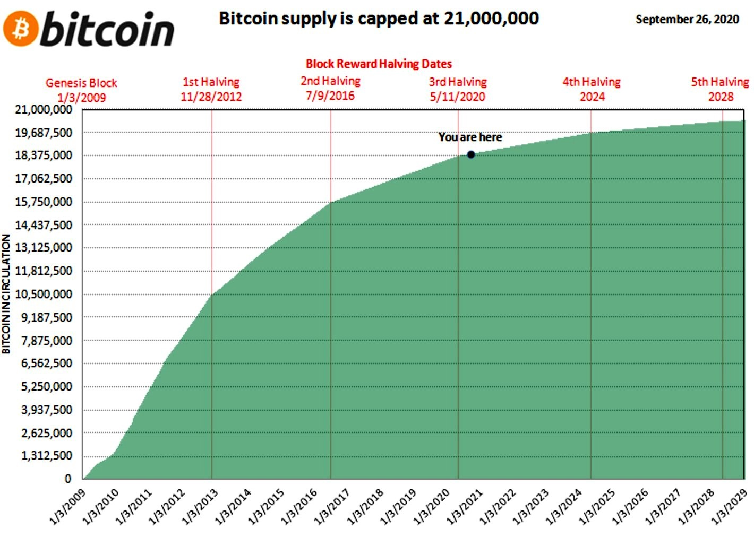
Halving

Slide 60
How much does it cost to produce a Bitcoin?
Until a few years ago a good computer was enough to produce (mine) Bitcoin, today thousands of very powerful processors and graphics cards are needed.
For the extraction of bitcoins, computers with specific processors called ASICs (application-specific integrated circuits) have been developed; these processors, in addition to having a high cost, also involve a high consumption of electricity.
According to some studies carried out, the energy required by PCs to validate a single transaction can reach up to 215 Kwh. If we take into account that around 350 thousand Bitcoin transactions are completed worldwide per day, the energy consumption is comparable to that of some countries such as Ireland, Denmark or Serbia.
Mining bitcoins therefore means using considerable amounts of electricity and hardware components.

Slide 61
Summary
Security: all-over-the world distributed database + encryption (all thanks to Blockchain technology)
Without intermediary (trust): automatic consensus (thanks to technology and Bitcoin → Currency On The Ledger)
Automatic remuneration of miners: generation of new Bitcoins

Slide 62
Ethereum
It is another platform based on blockchain technology
In order to run on the peer-to-peer network, Ethereum's addresses pay for the use of its computational power through a unit of account, called Ether, which therefore acts as both cryptocurrency and fuel.
Ethereum is different from the Bitcoin blockchain in that it allows you to create Smart Contracts. Even in Bitcoin, elementary smart contracts can be created. The peculiarity in Ethereum is that they are based on a complete Turing language

Slide 63
Example of application of blockchain in business
Notarization (immutability)
Supply Chain Management (immutability)
Smart Contracts (automatic payments)

Slide 64
Notarization
A hash containing the fingerprints of the files is recorded in the blockchain. All parties having access to the blockchain can individually verify the authenticity of these files.
HOW DOES IT WORKS?
The document is hashed. This means that the content of the document is summarized, or better represented, by a string of 64 characters (256bit).
The 64-character string is then put into a Bitcoin (or other) blockchain transaction using the OP_RETURN field.
A small Bitcoin payment is made to process the transaction and register it on the blockchain (you can also make a 0 bitcoin transaction, so paying only the cost of the transaction - variable but around 0.00001 bitcoin).

Slide 65
Supply Chain Management
Supply chains are complex and managing them takes hours upon hours of time from businesses and their teams, especially when different links in the chain are in different states or countries.
A blockchain’s immutable record-holding technology solves many issues associated with supply chain management by eliminating the lack of transparency
https://tech.walmart.com/content/walmart-global-tech/en_us/news/articles/blockchain-in-the-food-supply-chain.html

Slide 66
Hashing and Notarization

Slide 67
The blockchain is like a ledger with a transaction order distributed among many entities where only data can be added and each one keeps an identical copy. Each register in the accounting book has a time stamp, is immutable and can be checked individually.
Notarization: A hash containing the fingerprints of the files is recorded in the blockchain. All parties having access to the blockchain can individually verify the authenticity of these files.

Slide 68


Keywords
Immutable time stamp in the blockchain
Anchoring to the blockchain
How? Hashing

Slide 69
HOW DOES IT WORKS?
The document is hashed. This means that the content of the document is summarized, or better represented, by a string of 64 characters (256bit).
The 64-character string is then put into a Bitcoin (or other) blockchain transaction using the OP_RETURN field.
A small Bitcoin payment is made to process the transaction and register it on the blockchain (you can also make a 0 bitcoin transaction, so paying only the cost of the transaction - variable but around 0.00001 bitcoin).

Slide 70
OP_RETURN is a "free" field presented in every Bitcoin transaction: free, but limited in size.
For this reason, it is necessary to devise a method to "compress" the document you want to notarize into a string, using HASHING
HASH function: function that takes an input and returns a 64-character string as output. The input can be text, a photo, etc.
Hashing is irreversible since knowing the hash, it is mathematically IMPOSSIBLE to deduce the original text.

Slide 71
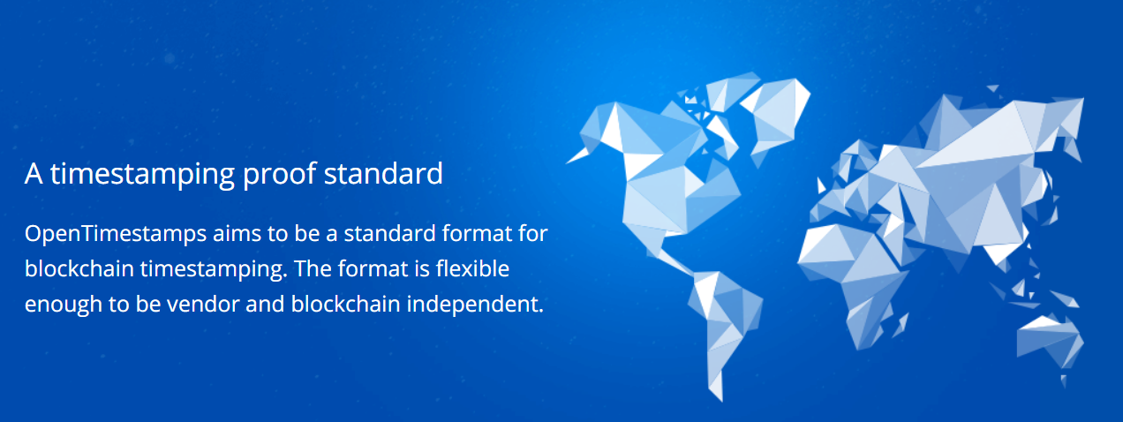


Slide 72
Hash function
“A hash function takes an input of any length and creates an output of fixed length.
It takes an input string and created a string of letters and numbers
“a0680c04c4eb53884be77b4e10677f2b”
This is referred to as the message digest.
It is also known as the digital fingerprint.”

Slide 73
Fingerprint, is that so?
Is it possible that two different files report the same Hash?
The hash projects a theoretically infinite sequence of data, in a finite hash and usually much shorter than the original file, so duplicates can happen.
Possible, but unlikely! And, with the most advanced hashing techniques it is difficult (if not impossible) to use this vulnerability (known as Collision) to modify documents for illegal purposes.
And then ... there is the avalanche effect, a property where a small variation in input produces a considerable variation in the hash.

Slide 74
An example
A contract is registered on the blockchain via notarization
A person wants to change a part of the contract and then prove that the changed part is the original contract.
How could it do? It should
a) Modify the contract according to its purposes
BUT SO THAT
b) The hash of the new contract is the same as the old one
It seems particularly unlikely that it will satisfy both a) and b) !!!!
“The answer is that it is NOT infinitely unique but the secret sauce is that it would take something like all the computers since the beginning of time a billion years to find a collision. ie two different inputs resulting in the same hash output. And that is good enough.”

Slide 75
Summarizing

Slide 76
DLT and financial services
It is not yet possible to think of a DLT that completely replaces the system of financial transactions (too large-scale). But it would be possible for two counterparties to create a DLT and use it for their transactions
The cryptography used in Blockchain could certainly be considered to make current databases more secure
Small-scale examples of DLT applications are evolving
Not just finance: The Blockchain can be used as a register in which to enter any type of information and consequently also a contract, an act or a certificate, avoiding the intermediation of third parties, but maintaining the guarantee of advertising

Slide 77
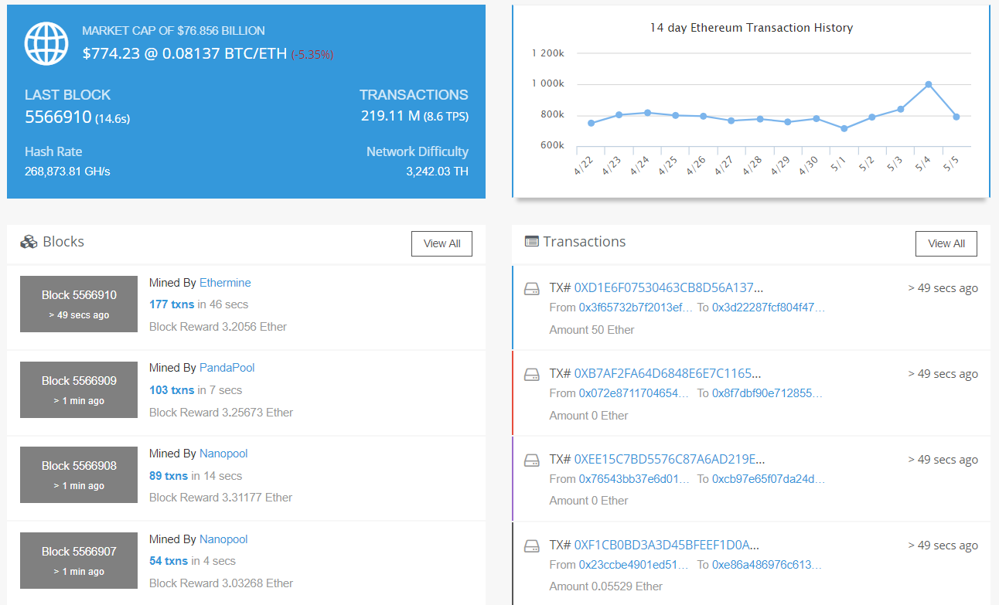
Scalability

Slide 78
Scalability
Bitcoin – 3 to 4 transactions per second – 1 block every 10 minutes
Ethereum – 20 transactions per second – 1 block every 15 seconds
PayPal – 193 transactions per second average
Visa – 1,667 transaction per second
https://altcointoday.com/bitcoin-ethereum-vs-visa-paypal-transactions-per-second/

Slide 79
Scalability and trust
PoW is expensive: it is the main cause of scalability problems (as well as memory problems: all nodes should store all transactions).
Solutions under study: off chain operations, proof of stake, proof-of-work only on some random blocks, permissioned ledgers
Permissioned ledgers (or private blockchains) can be controlled, and therefore can have ownership. When a new data or record is added to the blockchain, the approval system is not bound to the majority of participants but to a limited number of actors who can be defined as trusted.

Slide 80
DLT and financial services: why?
Three false myths?
Less expensive system
Safer
Faster
And
Currency on the ledger VS Currency not on the ledger
→ Are stable coins the solution?

Slide 81
Less expensive
Bitcoin transactions on the Blockchain cost (nearly) nothing.
But this is possible because new Bitcoins are created for the remuneration of the network nodes that work for the proper functioning of the system
What if the generation of new money is not allowed / possible?
The mirage of low operational costs derives from the false impression of free blockchain transactions: if one takes into account the seigniorage revenues invested, each transaction on the bitcoin blockchain has a cost of about 5-10USD
[ESMA Response]

Slide 82
Safer
Potentially yes: safer in terms of immutability (less than 51% attacks), but not privacy.
The system of remuneration of the nodes pushes to use their own computing power to make the system work, not to try to force it
The database is distributed all-over-the-world
What would happen if 2 and 3 were to fail, for example because some large intermediaries manage it on their own for the clearing of their transactions?

Slide 83
Faster? Not the technology, but the consensus
The current financial transaction system is "slow" not for a technological issue, but for a consensus issue
“Consensus by reconciliation”: a process that the financial markets have chosen as their “checks and balances” system.
It is therefore a question of moving to a new form of “decentralized consensus”: an automatic mechanism that allows transactions to be quickly validated. Like in Bitcoin!
Mechanisms to correct erroneous transactions? In Bitcoin & Blockchain they are not present! They cannot be present in the current DLT designed!

Slide 84
Currency on the ledger VS Currency not on the Ledger
Double Spending and real availability of the transaction object: Currency on the ledger (bitcoin) VS Currency not on the ledger (fiat money). In the first case (Bitcoin) it is possible to be sure of real availability. In the second?
How do we avoid double spending?
How can we be sure of the real availability of the transacted object?
Currency on the ledger (bitcoin), the transaction object is uniquely identified by the DLT
Centralized system (central bank type authority, clearing house)
External control by third parties
Confidence???

